Slide 1

Multi GPU Fine Tuning With DDP
10-April-2025
👩‍🏫 Under guidance of
Prof. Dr Handan Liu
Team - 10 Daxil Vala and Nihar Sanjaysinh Dabhi

Slide 2
Overview
Process of training models on multiple GPUs
Introduction to fine tuning
Workflow and methods used
Understanding factors affecting resource utilization
Visual analysis of GPU utilization and power consumption
References and resources

Slide 3
Process of training on multi-gpu…
Identify VRAM requirements
What is my model size?
Step-1
Step - 3
Step - 2
Step -4
What kind of accuracy is needed?
GPU Setup - (DDP or FSDP)
Effect of model size on VRAM requirements!
8 bits = 1 byte
16 bit number => 2 bytes

Slide 4
Dataset
Hugging face : mlabonne/orpo-dpo-mix-40k
This dataset is a carefully curated collection designed to optimize language model training using Direct Preference Optimization (DPO) or ORPO techniques, particularly for models like Llama 3.
Model
Hugging face : meta-llama/Llama-3.2-1B-Instruct
It's a 1 billion parameter model, making it relatively small compared to many state-of-the-art language models.
This size enables it to be more efficient in terms of computational resources and potentially suitable for deployment in environments with limited hardware.

Slide 5
Introduction to fine-tuning
Pre Trained Model
Targeted Task
Desired Behaviour
Serves as the starting point for fine-tuning. The model has already been trained on a large, generic dataset.
Fine-tuning is performed on a task-specific dataset. The dataset is typically smaller than the one used for pre-training.
The fine-tuning adjusts the model's weights to improve its performance on the specific dataset, making it better at handling the particular nuances or challenges of the task at hand.
Fine-tuning preserves general knowledge while specializing capabilities
Common applications include domain adaptation, instruction following, and alignment with human preferences
Modern techniques like LoRA make fine-tuning more accessible with limited resources and data quantization
Enables customization without requiring access to the full pre-training data

Slide 6
Understanding terminologies
Data Quantization
Supervised Fine Tuning
Tokenization
The process of converting a model's parameters (such as weights) from floating-point numbers (e.g., 32-bit floats) to lower bit-width representations (e.g., 8-bit integers). This reduces the model's memory footprint and computation requirements while maintaining performance.
This process guides the model to apply its pre-existing knowledge, gained from pre-training on a large dataset, to the specific task at hand. Supervised fine-tuning can significantly improve the model's performance on the task, making it an effective and efficient method for customizing LLMs.
Tokenization breaks down text into smaller pieces, such as words or parts of words. By doing this, AI can handle and analyze language more efficiently. This process is crucial for tasks like language translation, sentiment analysis, and text generation.

Slide 7


Libraries and tech used.
Huggingface 🤗 Accelerator()
Bits And Bytes
Framework agnostic library for distributed training
Hardware abstraction: Run identical code across different hardware configurations
Support DDP, FSDP, DeepSpeed and TPU training
Reduces memory usage with FP16/BF16 precision
Reduced VRAM requirements by up to 4x compared to FP16
Supports adaptive quantization based on tensor importance
Weights and Biases
Record metrics, hyperparameters and model articrafts.
Interactive dashboard for loss curves and performance metrics

Slide 8

Workflow
Initialize Accelerator
Load & Quantize Model
Load Dataset
Data Preparation
01
02
03
04
Start accelerator from Hugging Face
Configure logging and GPU monitoring with WandB.
Load LLaMA-3.2-1B-Instruct using AutoModelForCasualLM
Use 4-bit quantization with BitsAndBytesConfig for efficient training
Load mlabonne/orpo-dpo-mix-40k dataset
Split dataset into test/train and load dataset on Data Loader for DDP
Concatenate prompt + question for each sample.
Tokenize using the loaded tokenizer
Prepare Training Components
Training Loop (2 Epochs)
Save & Cleanup
05
06
07
Defining:
AdamW optimizer
Scheduler StepLR
Use accelerator to wrap model and data for DDP
For each batch:
Forward pass and compute loss
Backpropagate with accelerate
Optim. And Sched.
Save model post training completion.
Clear GPU memory and shut down accelerator.

Slide 9
Factors affecting resource requirement
⚙️ 1. Model Size
Larger models (e.g., 13B vs 1B parameters) need exponentially more GPU memory and compute power.
📊 2. Dataset Size
More training samples = higher memory & storage usage.
Impacts training duration and batch size feasibility.
🧮 3. Precision & Quantization
Lower-bit quantization (e.g., 4-bit) significantly reduces memory usage.
Mixed precision (e.g., bf16, fp16) enables faster training with less memory.
🔁 4. Batch Size
Bigger batches = more parallelism but higher VRAM demand.
Needs balance with available GPU memory.
🕓 5. Number of Epochs
More epochs = longer compute time and resource usage.
🛠️ 6. Optimization Strategy
Optimizer type (e.g., AdamW) and learning rate schedules affect training dynamics and memory usage.

Slide 10
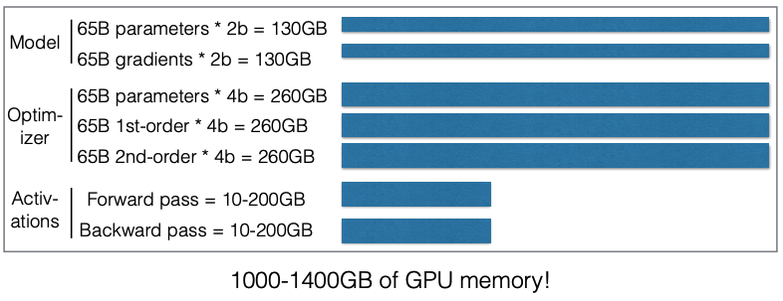
Exploding VRAM Needs with Increasing Parameters
As the number of parameters increases, the memory required for storing weights, activations, and gradients grows exponentially.
Limited VRAM can cause slowdowns or out-of-memory errors, especially when working with models that have billions of parameters.

Slide 11
GPU Performance Comparison for LLM Fine-tuning
Our Environment: NVIDIA H100
Core specifications: 80GB HBM3 memory, 3.9 TB/s memory bandwidth
Tensor cores: 4th generation, optimized for transformer workloads
Our configuration: 4x H100 GPUs in NVLink, 320GB total VRAM
Cost-Performance Analysis
H100 delivers ~3-4x performance of A5000 at ~2.5x the cost
58% reduction in training time compared to A100
Enables fine-tuning of 70B parameter models with 8-bit quantization
Key Advantages
Transformer Engine: 3-6x faster matrix multiplications for attention layers
Memory headroom: Supports larger models and contexts than previous generations

Slide 12
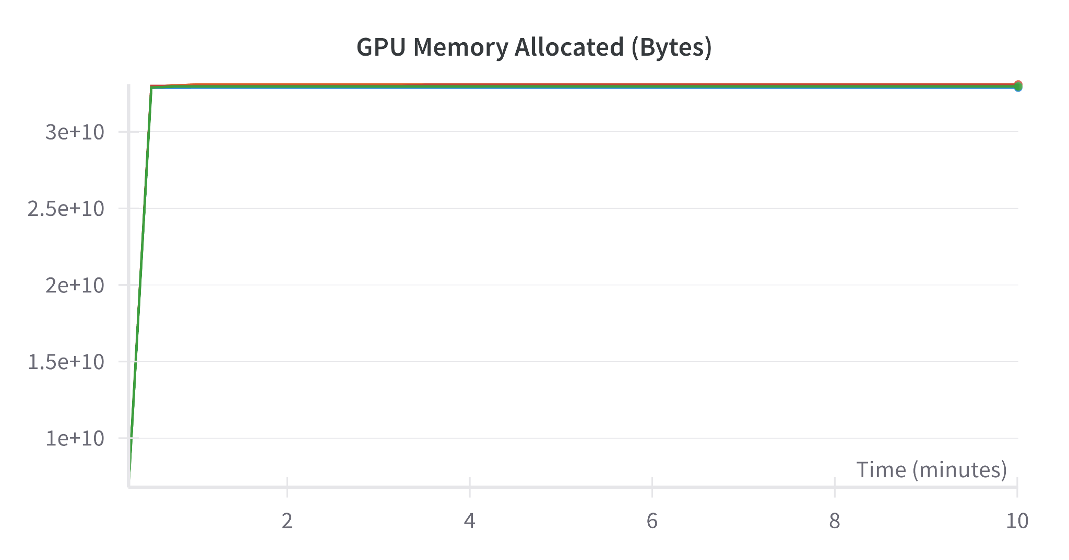
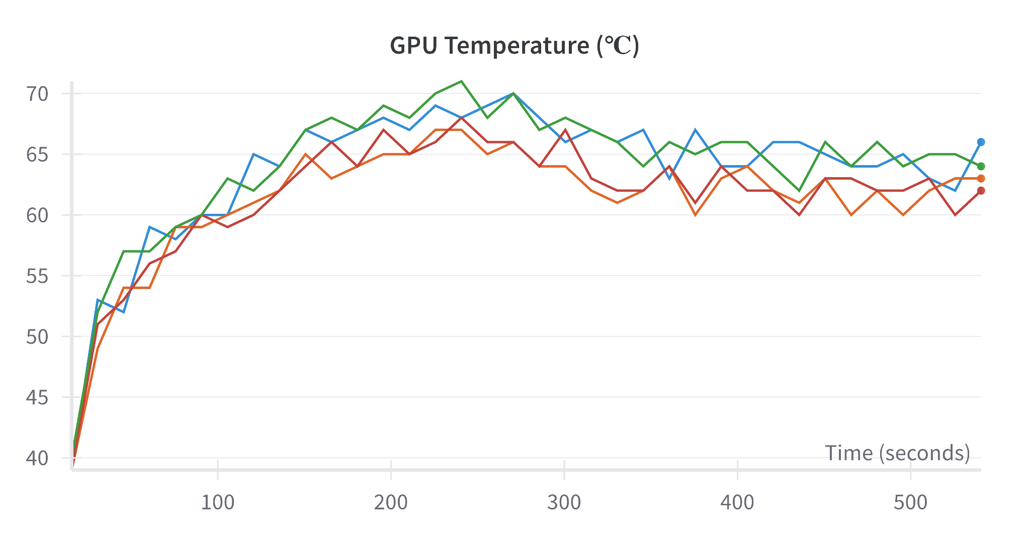
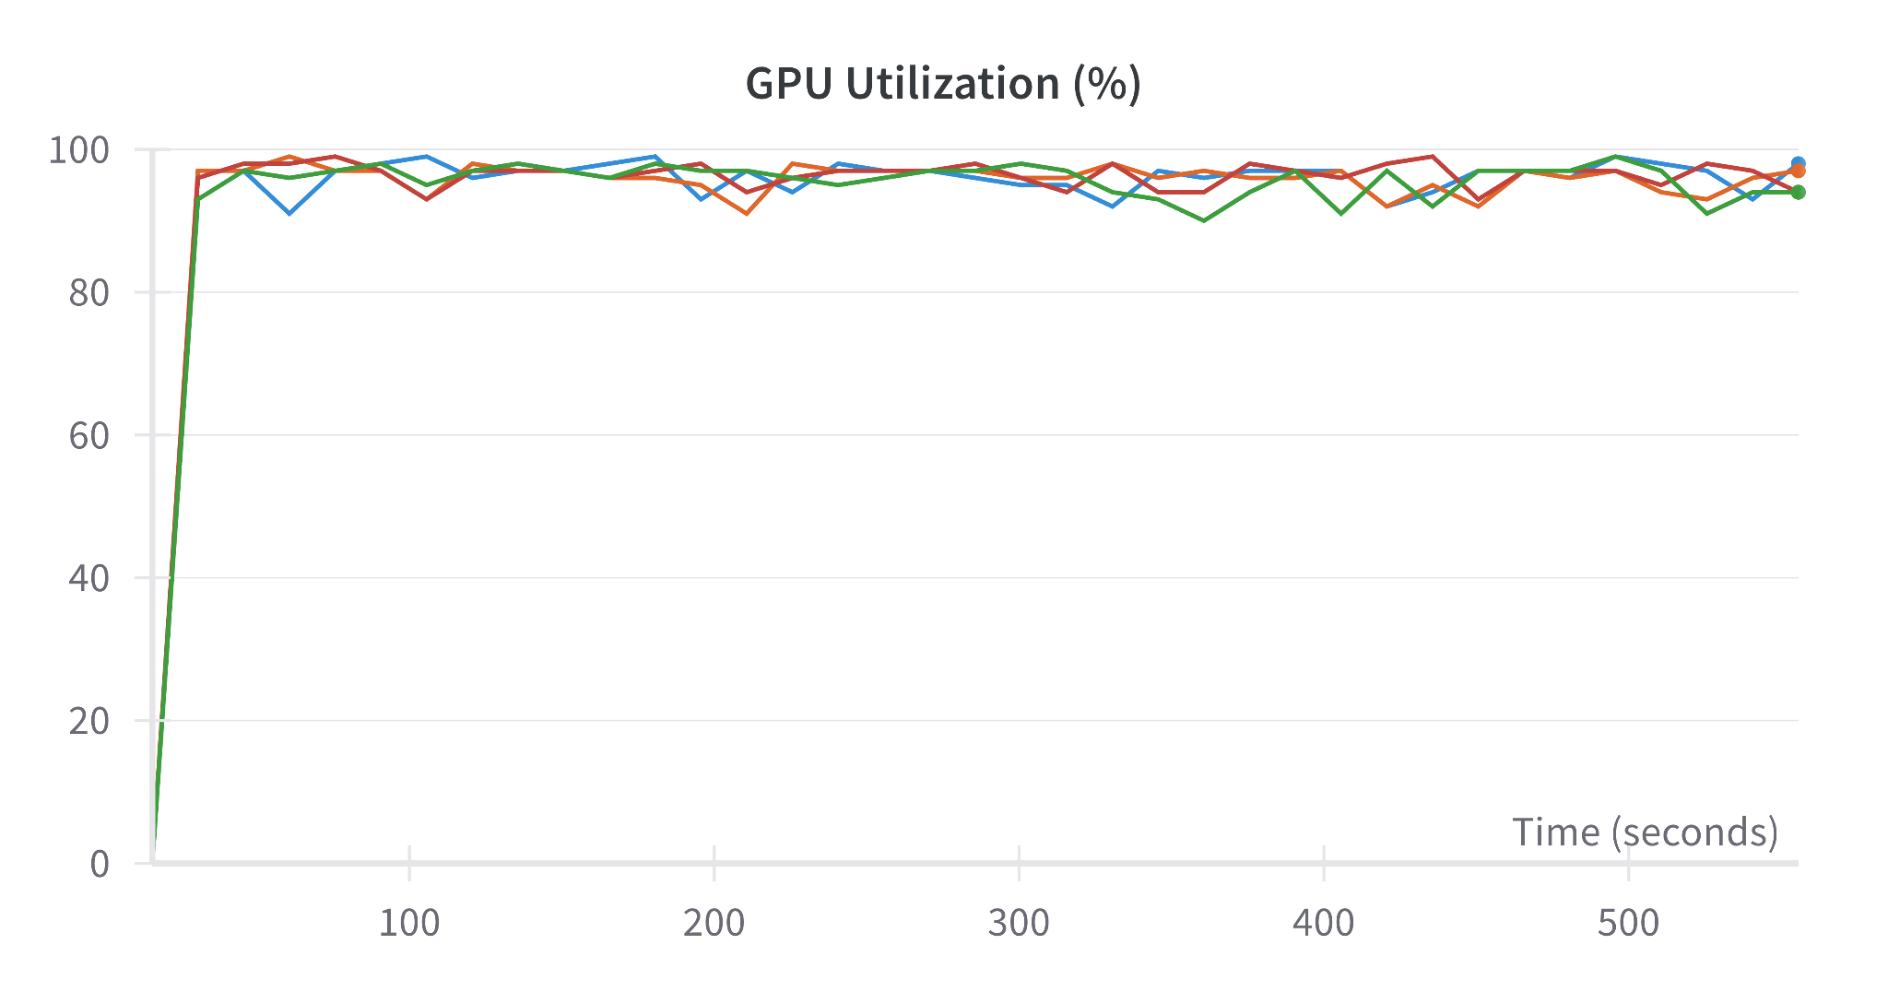
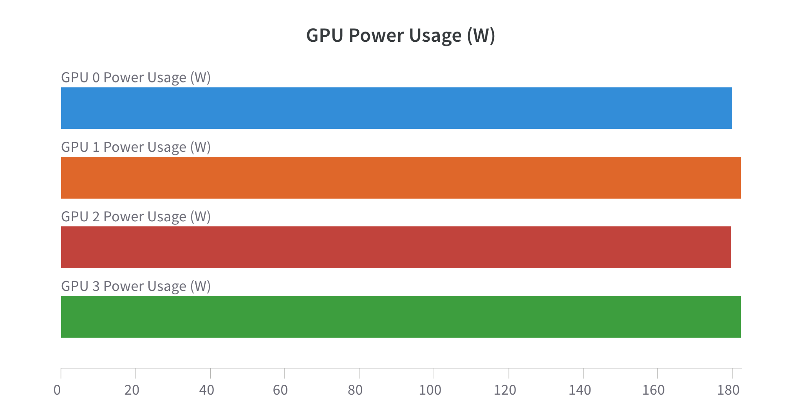
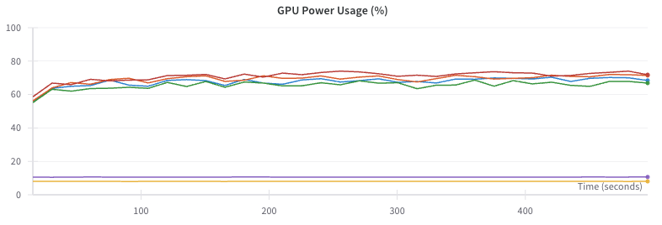
GPU Utilization: Visualizing Computation Load

Slide 13
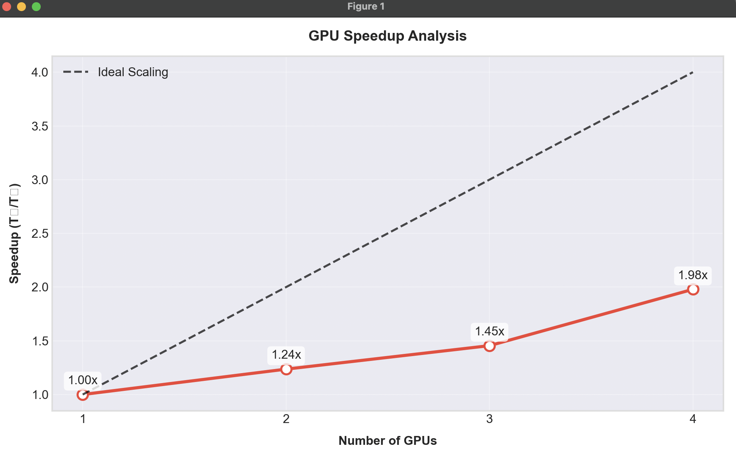
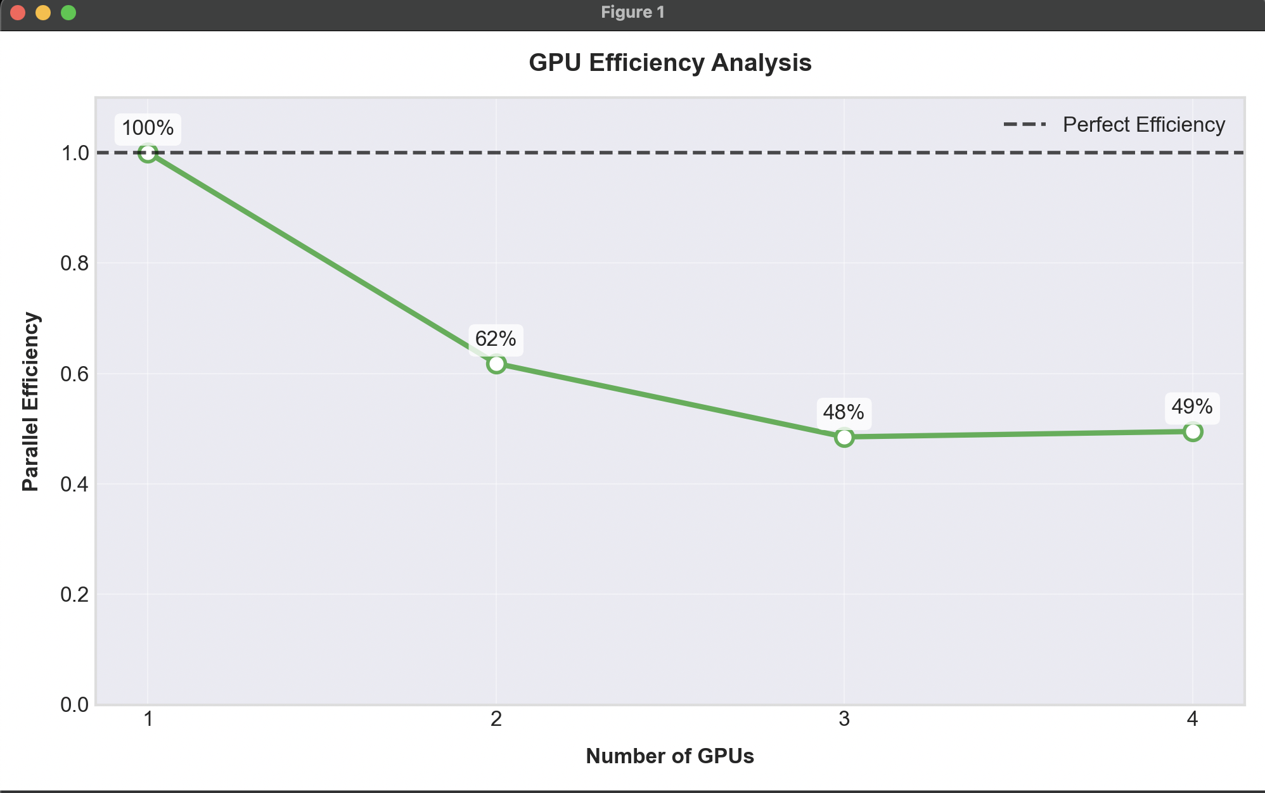
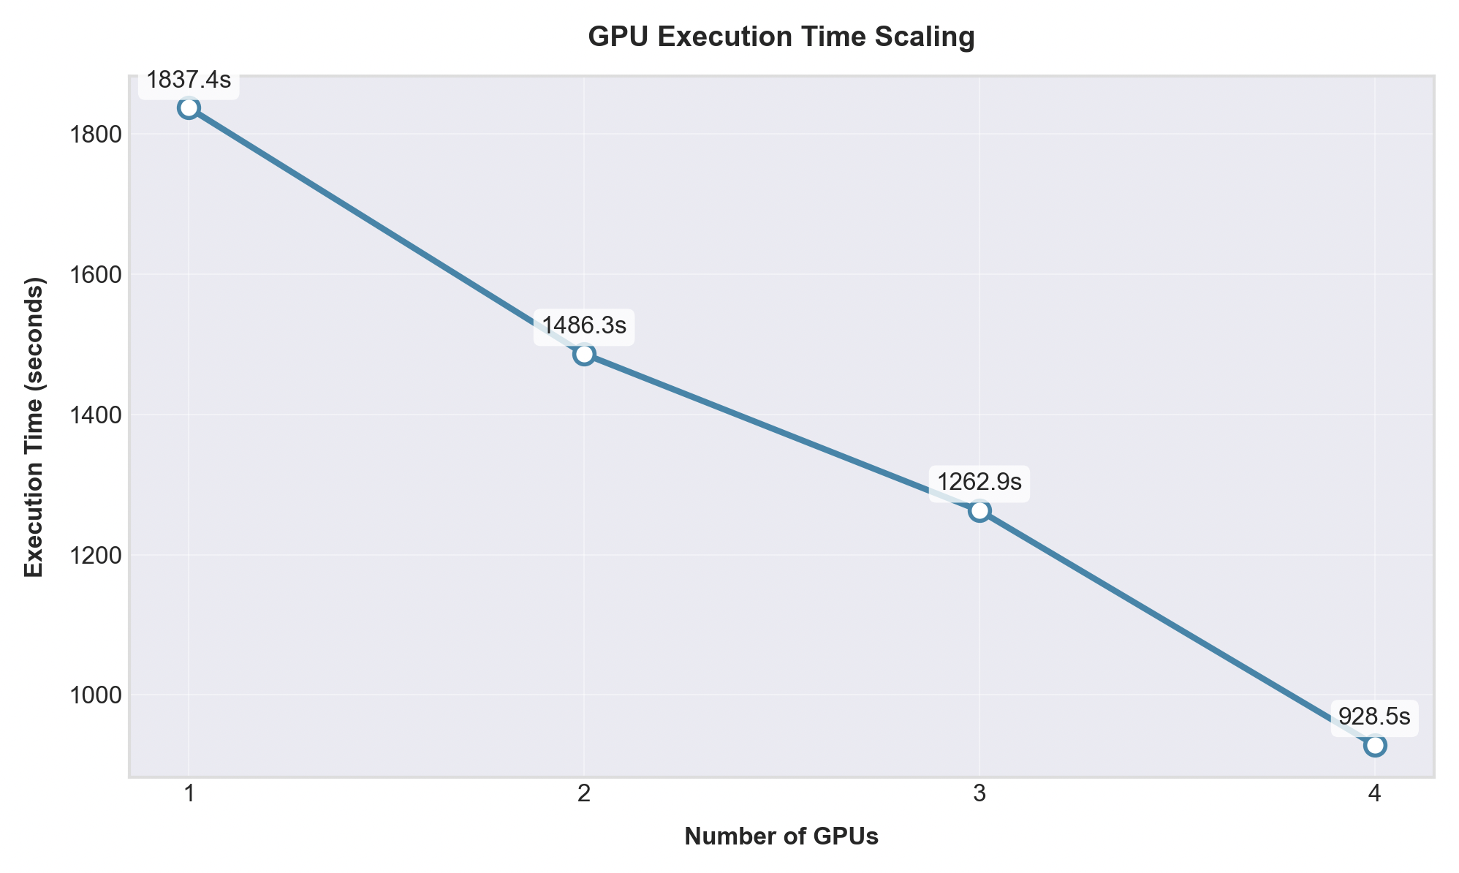
Performance scaling with GPUs

Slide 14
References and Resource
Libraries & Documentation
HuggingFace Transformers: https://huggingface.co/docs/transformers/
PEFT Documentation: https://huggingface.co/docs/peft/
Accelerate Library: https://huggingface.co/docs/accelerate/
BitsAndBytes: https://github.com/TimDettmers/bitsandbytes
Data Sources
ORPO-DPO-Mix-40k Dataset: https://huggingface.co/datasets/mlabonne/orpo-dpo-mix-40k
Meta Llama 3.2 Models: https://huggingface.co/meta-llama
Industry Benchmarks
Experiment Tracking: https://wandb.ai/yourteam/llm-orpo-finetuning
NVIDIA H100 Technical Overview: https://www.nvidia.com/en-us/data-center/h100/

